Slide 1

Game Management
Reducing Referee Abuse
Pioneer Soccer

Slide 2

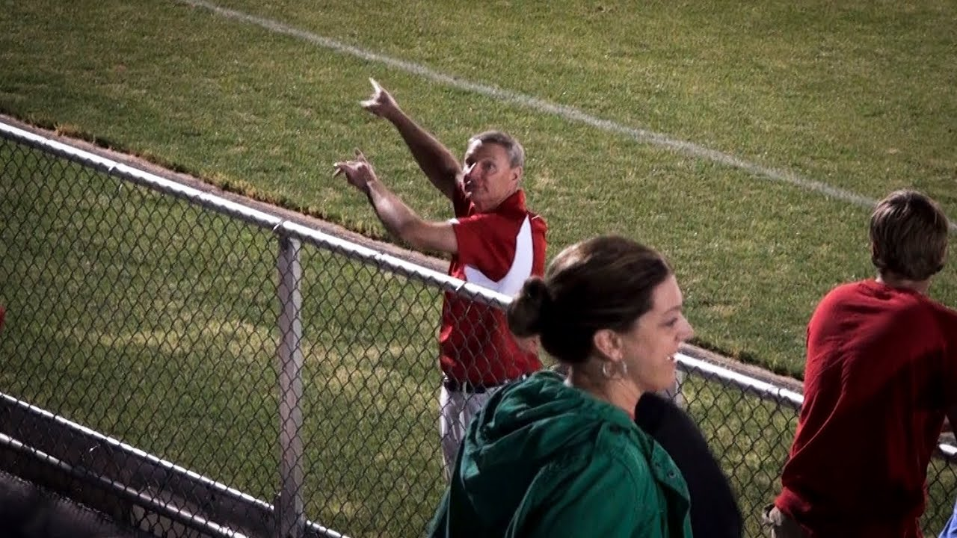

Slide 3
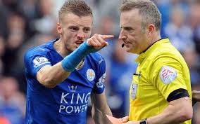
Why is this important
- Referee Safety
- Referee recruitment and retention
- Undermines authority
﻿﻿- Reduces game flow
﻿﻿- Reduces enjoyment for all
﻿﻿- Can escalate or spread if not dealt with
Pioneer Soccer

Slide 4

STATISTICS
Sportsmanship/Referee Abuse
“Is sportsmanship getting better or worse?”
  - 68.81% worse
  - High school level, 69.48%
- More than 50% of all respondents have feared for their safety
- 12% of all officials have been physically assaulted during or after a sporting event.
- 72% of referees report Sportsmanship is getting worse
- Referees report 89% of poor sportsmanship comes from Parents/fans and Coaches
- 67% of referees have had a parent removed
PIONEER SOCCER
NASO Statistics 2023 survey

Slide 5

Impact on the Match
- Referee Recruitment is down
  - 70-80% of New referees quit within 1-3 yrs.
  - # 1 Reason: Referee Abuse
  - Almost 80% of referees reported having accepted more games due to shortage
  - Aging Referees - Averages across the country are in the 50’s
Pioneer Soccer
NASO Statistics 2023 survey

Slide 6
concerns
- Parking
  - No designated parking, especially for big events (Senior Night, night games, etc.)
- Game Manager (AD, Security, Other school official)
  - AD’s stretched thin (too many games at one time); Not always at field
- Security
  -Is it really security??? / Bigger issue of having someone walk you to your car
- follow-up or consequences to inappropriate parent behavior
  - Piaa has imposed limits and resultant consequences on Coaches and players for unsportsmanlike behavior
Pioneer soccer

Slide 7
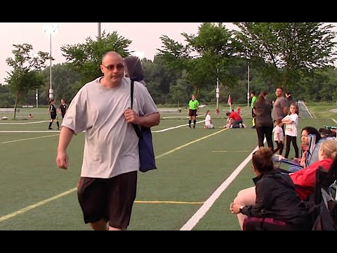
Pioneer Soccer

Slide 8
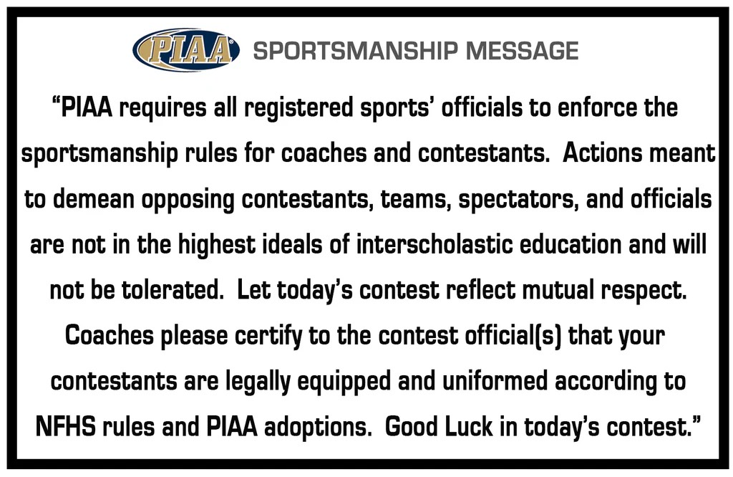


Player and coach management
Pioneer Soccer

Slide 9
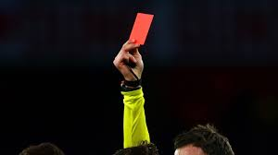
PLAYER AND COACH MANAGEMENT
- VERBAL WARNINGS
Cautions
- YELLOW AND RED CARDS
  - RED RESULTS IN MISSING REMAINDER OF CURRENT MATCH AND NEXT MATCH
- SUPPLEMENTAL DISQUALIFICATION
  - “Any ejection involving confronting, contacting, or addressing a coach, contestant or official using foul or vulgar language, ethnic or racially insensitive comments or physical contact results in a 2 game sit out penalty”.
  - In addition: Players can not return to play until completing the Nfhs sportsmanship program on-line and present completion to the school principal who will forward to PIAA. Coaches can not return until completing on-line Sportsmanship program and teaching and modeling behavior program.
  - Report to A.D. and coach that Disqualification will be a supplemental
Pioneer Soccer

Slide 10
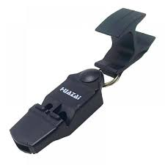
State Level
“Respect the whistle act”
Bill 842
An Act amending Title 18 (Crimes and Offenses) of the Pennsylvania Consolidated Statutes, in assault, providing for the offense of harassment of sports official.
Passed October 25th, 2023
State law currently contains increased penalties for assault against a referee. Presently, these charges are considered a first-degree misdemeanor. These protections were deemed to be necessary by the legislature given the violence aimed at referees.
  - Created a separate offense of harassment towards an official
  -SB 842 grade the same conduct (harassment) against a sports official as third-degree misdemeanor
Pioneer Soccer

Slide 11

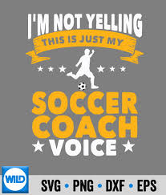
Pioneer Soccer

Slide 12


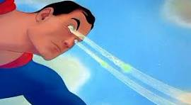
emotional responses
- Are to be expected - We are all human
  - Don’t respond in these situations
    - This will only escalate the situation
    - Can create a more hostile environment
    - Can create a sense of a power trip
    do remain vigilant and monitor behaviors
    - Don’t allow it to become persistent
Pioneer Soccer

Slide 13
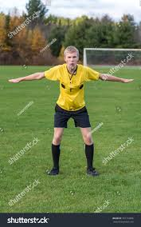
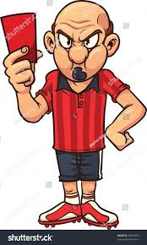
Referee ownership
How do we as referees contribute to inappropriate behaviors
- Arrive with air of being on a power trip
- Lack of professionalism
- By Not setting limits with coaches, parents, spectators
- When we don’t support one another
- Not demanding change and consequences to inappropriate behaviors
- Lack of representation to combat abuse
- Arriving late
- Appearance of favoritism
- Referee shortage (doing to many games / Level not appropriate)
However, there is no excuse for abuse/inappropriate behavior
Pioneer soccer

Slide 14
Abusive behavior
What isn’t acceptable in your primary professional workplace too shall be the same on the pitch
It is NOT part of the game
Unacceptable Behaviors
  -Personal insults
  - actions that publicly questions you, insults you, undermines your authority/role, or calls attention to you
  - Persistent dissent/complaints
  - Provocative statements - statements that would shock others
  - Threats - take all threats seriously
Pioneer Soccer

Slide 15
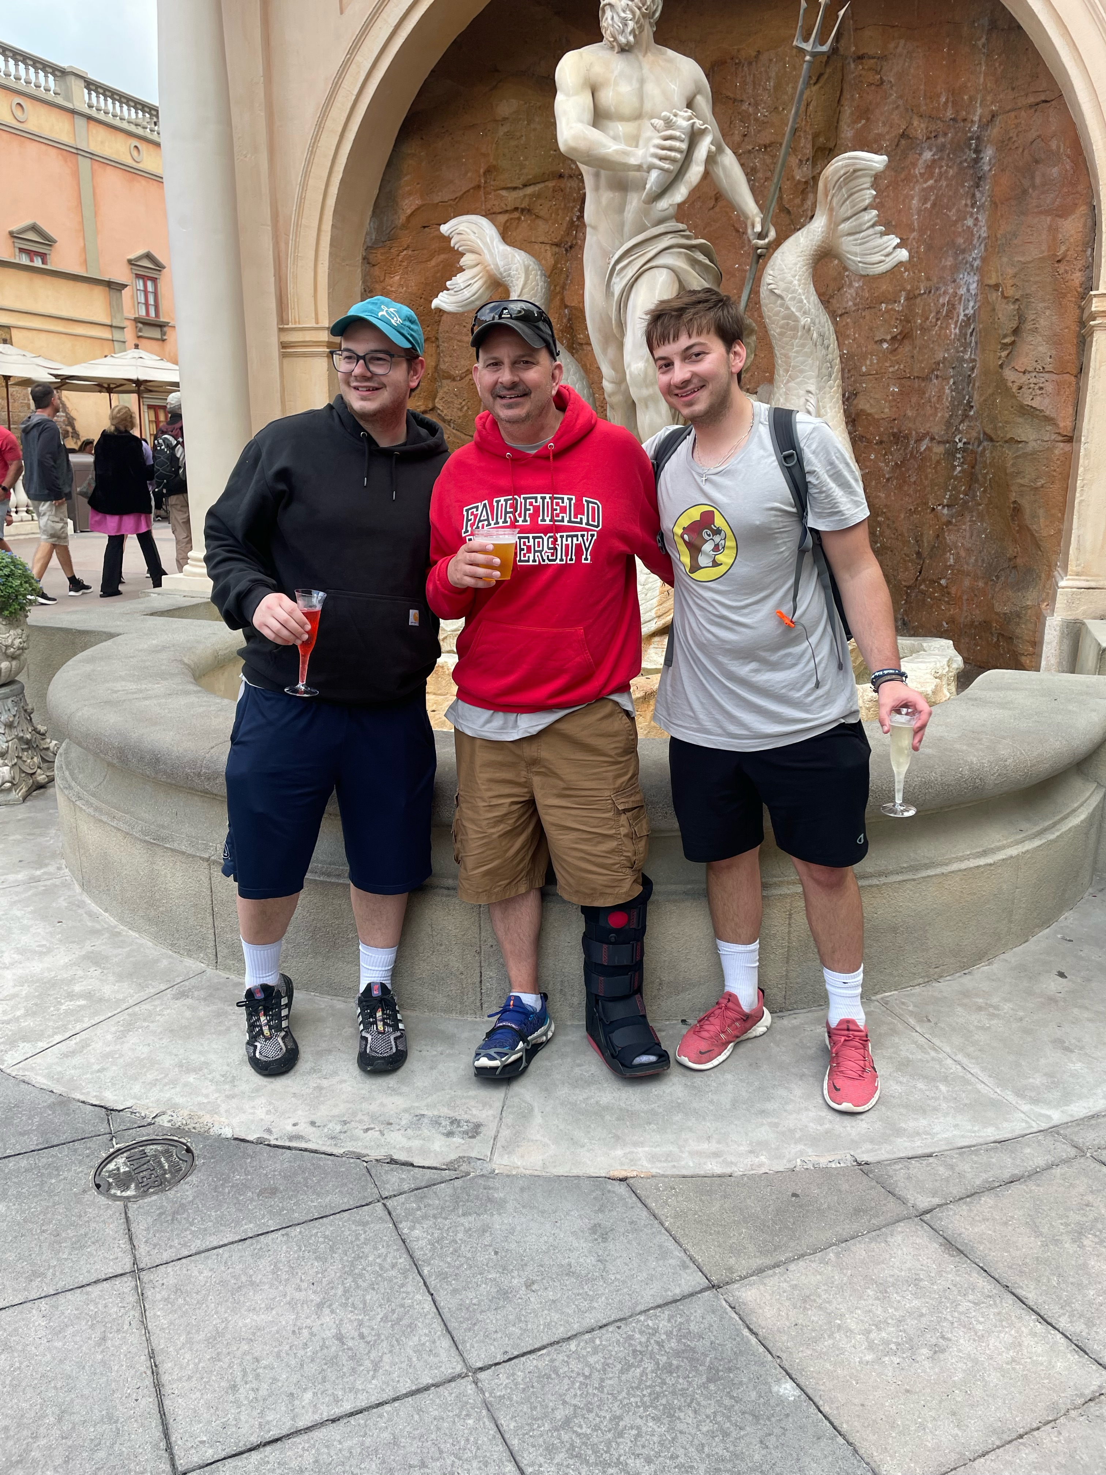
Preventative Strategies
- humanize yourself - help coaches and parents/spectators to see beyond the uniform
- introduce yourself to coaches prior to match
- engage in conversation with coaches/players prior to the match
Pioneer soccer

Slide 16
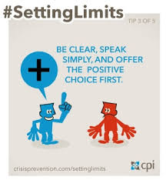
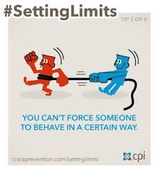
managing abuse/inappropriate behavior
setting expectations and limits
-Must be clear and concise
- need to be reasonable
- are enforceable
- Setting Limits is not the same as an ultimatum
- Setting limits is about teaching not punishing
- Setting limits is more about listening than talking
Pioneer soccer

Slide 17
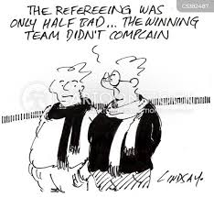
Managing abuse/inappropriate behavior
Do:
- Be calm
- be respectful
- be courteous
- Be firm
- watch your tone, volume, and cadence
- model appropriate behavior
- set clear behavioral expectations
- watch your non-verbal communication
pioneer soccer

Slide 18
managing abuse/inappropriate behavior
intervention:
- Explain the problem
- outline the consequences if the behavior doesn’t change
- Make it clear that it is their decision of the outcome
- ensure understanding and thank them
- follow through with consequences
- don’t add any additional emotion - goal is to deescalate the situation
pioneer soccer

