Slide 1
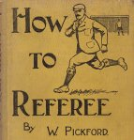
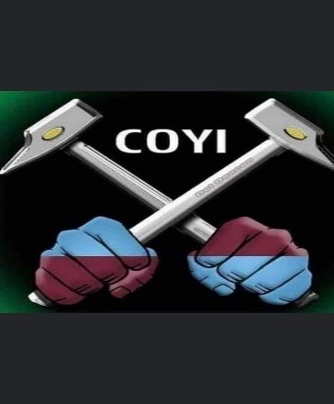
Double Dual System- Post Season Play- A Review
PIAA Three Referee Officiating System
Pioneer Chapter
October 4, 2023

Slide 2
What do the Rules say?
The Double-Dual System was devised in 1973 by Joseph Bonchonsky of Torrance, California to minimize misconduct in a tournament.
,The Rules book used to define it as:
”Three qualified referees work together as a team to manage the game.. Equally share in control, a decision by any one is valid… Concentrate attention in specific areas”

Slide 3
Principle:
Three qualified referees work together as a team to manage the game. All have whistles and cards.
All three function on the field:
Can move on and off the field, as needed. Unlike Diagonal system there are no positional restrictions. Can stay close to play and players.
Each official has primary responsibility for a specific area of the field but designed so two officials can see the same play
Officials are encouraged to work together. The closer official is expected to make the call but if screened or has a bad angle can get help.

Slide 4
Principle (cont.)
Equally share in control:
A decision by any one is valid
All record misconduct to assure completeness
Concentrate attention in specific areas:
Where patterns make observation most effective
All responsible for any violations

Slide 5
Advantages of DDS
Greater Officiating Resources- more officials enforcing the Rules
Increased Surveillance-three referees compared to a single referee
Close Proximity to Play-Referees are physically closer to play with increase in flexibility of movement.
Spontaneous Decisions-shortened reaction time to violations
Behind play fouls better controlled
Distributes Game Demands- Less stress as critical decisions are responsibility of all three referees

Slide 6
Problems with DDS
Unfamiliar referee partners, or not used to three whistle system.
How are we going to work together? Ask questions of each other. Good Pre Game is important for effective teamwork.
Inconsistency- three referees with probably different styles
So watch how the first referee in the rotation sets the tone and try to follow it.
Positioning- Since all three can move around the pitch – make sure you do not duplicate angles of view.

Slide 7
Why is good Teamwork important?
Improves game control through:
Better cooperation, especially working with unfamiliar team or match officials not used to the three whistle system
Removal of ambiguities (everybody on the same page).
Improved communication-better decisions
If Teamwork is poor ,,,,,,,,,

Slide 8
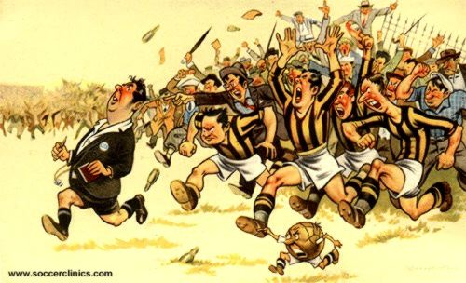
Is this You?

Slide 9
Communication: Pre Game
Arrive as a team at least one hour before the game. Wear similar uniforms.
Talk to and ask questions of each other, Not just a lecture by the Head Referee. Review:
Responsibilities and priorities
Positioning – dynamic and set plays
What ifs- Mass confrontation, crowd trouble, weather problems, bad injuries, floodlight failure, security issues
Knowledge of the teams
Agree rotation

Slide 10
Communication: Pre Game
Check the field, balls, players together
Speak to the game manager, timer, ball people
All attend the captains and coaches conference.

Slide 11
Communication: During the Game
Look at each other at every stoppage
Mirror signals
All track time and goals and cards and injuries
Support each other’s decisions (even if you think they are wrong!)
Compare notes at half time- cards, score, players to watch (P.I.), things to improve
Compare notes at full time- cards, score, things to improve. Collaborate on game report if needed.

Slide 12
Rotation:
Agree rotation at pregame. Usually the senior referee goes last.
Rotate (unobtrusively and when convenient) at a stoppage.
Between the 26th & 27th minutes ( about 13-14 minutes left in the half)
Far side official and Center official change positions
#2 CR ends the first half and restarts the second half
Before starting the second half the side referees exchange positions,
Between the 53rd & 54th minutes (about 26-27 minutes left in the game) Far side official and Center official change positions

Slide 13
Referee Responsible for Managing Restart and Second Whistles (when required)
Restart Referee
1. Start of Play Center
2. Free Kicks Center
3. Off side SR stops play; Center restarts
4. Substitution Anyone stops play; Center restarts
5. Corner Kick Center
6. Goal Kick Center
7. Penalty Kick Center
8. Throw in Center
9. Drop Ball Center (or SR if ball dropped to defense in their penalty area)
10. Signals CR always signals direction/ SR mirror direction on throw in side/ ALL indicate IFK and substitutes.

Slide 14
Overtime Periods (Sudden Victory) Post Season 2x15 (State 2x20) (5 minute break flip coin)
Referee Rotation
Start as original crew set up –
#1 CR handles the 1st 10 minutes of first overtime period
#2 CR handles last 5 min of first half , and first 5 minutes of second half. (side referees switch sides during the half time interval (2 minute interval)
#3 CR handles the last 10 minutes of second OT period
If “kicks from the mark “are required #1 CR handles the administration and execution of the process;, CR 2 & 3 handle players and goal judge. ( Check PK mark distance}
For State games amend the above times accordingly.

Slide 15
Officiating positions
CENTER REFEREE
Work the middle
Similar to R in diagonal system
Similar to TR in dual system
SIDE REFEREES
Work the wings
Similar to AR in diagonal system
Similar to LR in dual system
Notes:
Advantage over dual system
Introduces a third official in the middle of the field – where most of the action is!
Allows the officiating team to MANAGE the game, not just OFFICIATE it
Advantages over diagonal system
ARs become referees, helping the entire officiating team manage the game
ARs are closer to the action
Referees can take more intelligent positions, without having to duplicate responsibilities with ARs

Slide 16
MOVEMENT PATTERNS
SR1
CR
SR2

Slide 17
Movement patterns – key points
Continuous, flexible movement patterns to adjust to the play of the game
Side referees will often be on the field
Two ways to “box in” the play and the players
Always by the 2 side referees
Normally also by the center referee and lead side referee

Slide 18
Center referee movement
Vary the diagonal pattern
Box in the play
Avoid interfering with players and play
Be close to anticipated trouble spots
Notes:
Vary the diagonal pattern
Move to where game control is needed
Do not necessarily follow a rigid diagonal
Normal diagonal movement pattern
Slightly behind and wide of the play (e. g., 10-20 yards away)
Added advantage: Easy eye contact with lead side referee
“Box in” the play
Keep players and play between center referee and lead side referee
Stay wide!
The lead side referee is on the field!
Pattern is more of an S-curve than a diagonal
Avoid interfering with players and play
Anticipate where the ball will go next
Stay away from this area!
Avoid having to get out of the way of the ball
Avoid being hit by the ball
Anticipate where the players will go next
Stay away from this area!
Avoid interfering with players who are actively moving to attack or defend
Be close to anticipated trouble spots
Example – play moves into the penalty area
Leave diagonal to get to this potential hot spot
Be careful not to interfere with play! (remember point 2)
Example – play moves into the coffin corner
Leave diagonal to get to this potential hot spot

Slide 19
CENTER REFEREE RESPONSIBILITIES AND MOVEMENT
CR

Slide 20
Side referee movement
Parallel to the touchline
Maintain the offside position
Covers about 2/3 of the field (not just ½)
Play in the side referee’s half of the field (i.e., the “active half”)
Play in the opposite half of the field (i.e., the “inactive half”)
Notes:
Parallel to the touchline
Inside the touchline when necessary
Maintain the offside position
Second-to-last defender or the ball… whichever is closer to the goal line
Covers about 2/3 of the field
Not restrained by the halfway line
Play in the side referee’s half of the field (i. e., the “active half”)
Side referee is normally ahead of the ball
Side referee covers touchline and goal line
Side referee follows all balls to the goal line
Side referee does not stop short or anticipate – he/she goes ALL THE WAY to the goal line!
Side referee covers offside
Side referee must be prepared for an offside decision
Play in the opposite half of the field (i. e., the “inactive half”)
Side referee is normally well behind the ball, the active play, and the center referee
Side referee covers off the ball incidents
Side referee covers incidents on the “blind” side of the other two referees
Side referee penetrates into the opposite half when appropriate
Supports the other referees
Corner kick at opposite end of field
Long ball to “coffin corner” at opposite end of field
Support is provided only when it does not compromise ability to cover primary concerns (e. g., offside decision on a counterattack)

Slide 21
SIDE REFEREE RESPONSIBILITIES AND MOVEMENT
SR1
SR2

Slide 22
Pattern of Coverage

Slide 23
Position for Corner Kick

Slide 24
Position for Goal kick

Slide 25
Position for Throw In
Vary position

Slide 26
Position Free Kick
SR 1- Vary position

Slide 27
Position Penalty Kick

Slide 28
Fourth Official (if assigned)
Fourth Official comes under the jurisdiction of the Head Referee and performs those duties assigned by Head Referee,
Partcipates in checking teams, field and equipment.
Manages players and coaches and other personnel in technical areas.
Manages substitutions
Assists Referee Team in controlling game by notifying them of misconduct out of their view.

Slide 29
Summary
Most important element is good Team work with emphasis on a very good Pre Game!

Slide 30
Any Questions?

