Slide 1
Soccer Officials Evaluation Program
Training Webinar
12 Oct 2023

Slide 2
Our goals for tonight
We’re rolling out the new PIAA Officials’ Evaluation Form
Review the expected protocol for conducting evaluations
Walk through the new form
Reinforce expectations regarding grading

Slide 3
Key concepts
Expected evaluator protocol is known to be effective (discourage ‘surprise’ assessments!)
More consistent evaluations statewide
Refinement and clarification of evaluation criteria
Tailor the program to the unique priorities of the interscholastic game

Slide 4
Evaluation protocol
Expected evaluator protocol includes:
Pregame introduction
Postgame debrief
Evaluation purposes:
‘Coach’ our officials
Provide effective feedback to PIAA
Narrow disparities in evaluation results

Slide 5
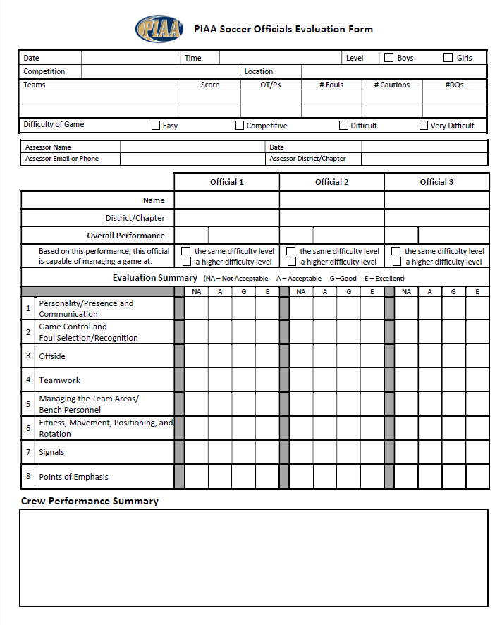
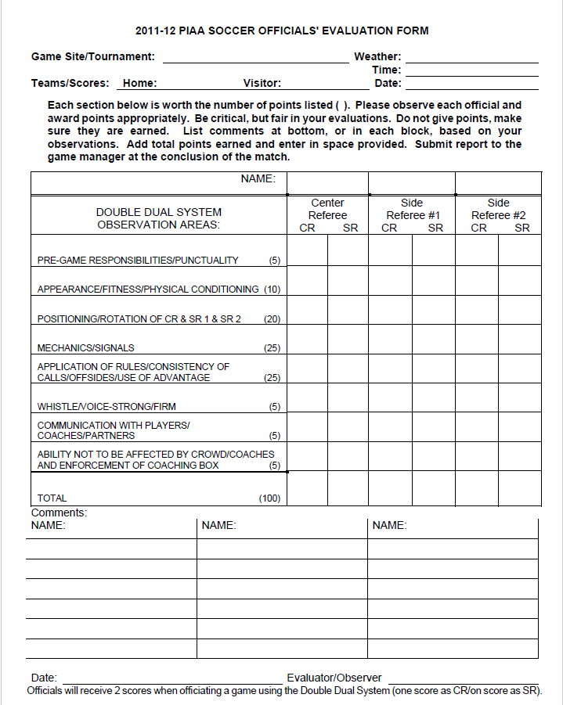
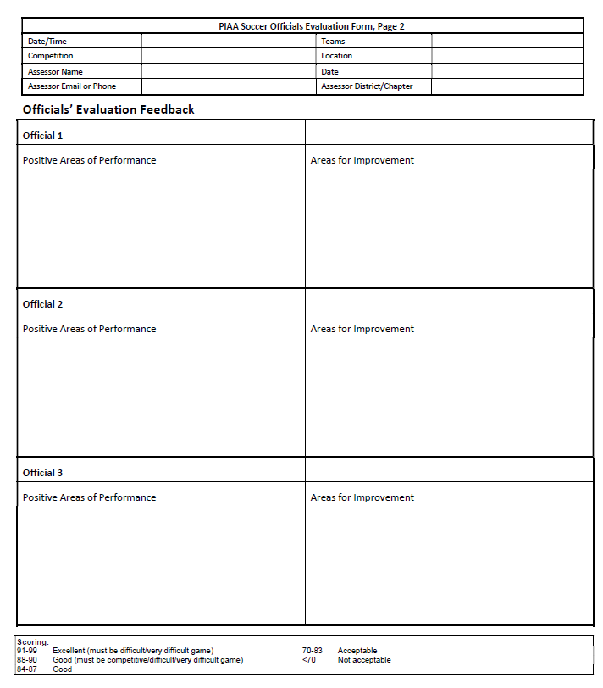
Evaluation form
Replace the matrix of grades…
…with a form that encourages written feedback…
…and captures a single overall score

Slide 6
Evaluation form components
Feedback
Performance focus areas
Difficulty
Overall score

Slide 7
Feedback: Crew level
Summary of the crew’s performance
Text correlates to focus criteria and ratings/scores (more on that later!)
Helps both PIAA and the official (better insight than just a grid full of numbers!)

Slide 8
Feedback: Each official
Top 3 areas of positive performance
Includes appropriate facts and specifics for better insight
Crucial to the official’s confidence

Slide 9
Feedback: Each official
Top 3 areas where the official can improve
Includes appropriate facts and specifics for better insight
Crucial to the official’s continued development

Slide 10
Performance focus areas
Personality, presence, and communication
Game control and foul selection/recognition
Offside
Teamwork
Managing the team areas/bench personnel
Fitness, movement, positioning, and rotation
Signals
Points of emphasis

Slide 11
Focus area 1: Personality, presence, and communication
Ability to ‘manage’ the game
Tailored personality, body language, etc. to defuse situations rather than inflame them
Open line of communication with participants
Fair and firm as appropriate
In other words…
Making all of the correct calls isn’t enough
The way in which the official works…earns the respect of the participants and makes the game go smoother

Slide 12
Focus area 2: Game control and foul selection/recognition
Think ‘safety, participation, and sportsmanship’
Protect the players safety at the interscholastic level
Avoid overofficiating, and avoid underofficiating
Find (and re-find) the ‘sweet spot’
Modify as needed as the game heats up/cools down
Use discretion and common sense
Courageously deal with misconduct
Be proactive – prevent vs. react (without ‘coaching’)
‘Read’ the game

Slide 13
Focus area 3: Offside
Decisions reflect current understanding of key concepts
Definition of offside position
Interfering with play
Interfering with an opponent
Gaining an advantage
Deliberate save
Deflected by a defender or played by a defender
Benefit of doubt goes to the attacker
‘Wait and see’

Slide 14
Focus area 4: Teamwork
Crew members worked effectively together
Think ‘seamless’ in terms of coverage, responsibilities, game control, etc.
Crew members used standard mechanics to support one another
Trail official coming upfield to spot ball on free kicks
Any official identifies waiting substitutes
…etc.

Slide 15
Focus area 5: Managing team areas/bench personnel
Think ‘extension of the classroom’ and sportsmanship
Ability to defuse when possible…
…but also have the courage to deal with improper behavior when necessary
Leave the field immediately after the game – crew does not stay for postgame handshake

Slide 16
Focus area 6: Fitness, positioning, movement, and rotation
Fitness
Able to keep up with the pace of the game
Able to stay with the offside line, get to the goal line
Able to pinch upfield to help partner (dual system)
Dynamic positioning
Able to stay out of the players’ way, passing lanes, etc.
Adjusts positioning to get good angles of view
Anticipates the next phase of play (e. g., ‘drop zone’)
Static positioning – takes proper position on set plays
Proper and timely rotation (double dual system)

Slide 17
Focus area 7: Signals
Ability to consistently use NFHS and PIAA signals as expected
This includes the foul signals!
Includes the practice of mirroring partner(s) signals

Slide 18
Focus area 8: Points of emphasis
Ability to officiate the game according to the current season’s points of emphasis identified by NFHS and PIAA
NOTE: POE vary each season, but the form does not need to change

Slide 19
Rating concepts
For each performance focus area:
Excellent [A]
Standout performance – an example for other officials to follow
Good [B/C]
Performance exceeded the needs of the game
Acceptable [C/D]
Performed as expected to meet the needs of the game
Not acceptable [F]
Overmatched; performance did not meet the needs of the game

Slide 20
Difficulty level concepts
Consider the level of skill needed to effectively officiate the match
Easy
Just show up
Competitive
Requires more than just blowing the whistle
Difficult
Requires focused and determined officiating from beginning to end, so that the game does not get out of control
Very difficult
Extremely rare instance where ‘difficult’ isn’t enough – the game is ‘on the brink’ right from the first whistle

Slide 21
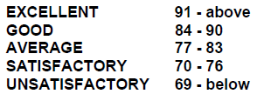
Overall score
Evaluations are an ‘extension of the classroom’ for officials – so there is a score…
…but for the scores to be more meaningful, we need to provide more guidance…

Slide 22
Overall score concepts
Overall score is a summary rating that considers:
Difficulty rating
Performance focus area ratings
Text feedback (which should support the difficulty and performance area ratings)

Slide 23
Overall score concepts
If you perform assessments in other organizations:
Lower expectations than that of a college match
Similar (or maybe slightly higher) expectations to that of a US Soccer grassroots official (think ‘grade 8+’)

Slide 24
Overall score
Excellent | A+ | 95-99 | [Difficult+] Truly exemplary performance. A model for all officials to follow. Video of the game could be used as a clinic.
 | A | 91-94 | [Difficult+] Outstanding performance. Only minor areas of improvement identified.

Slide 25
Overall score
Good | B+ | 88-90 | [Competitive+] Noticeably solid performance. Smoothly established and maintained control. Exceeded the needs of the game. No errors that affected player safety or the match outcome.
 | B | 84-87 | Clean performance on an easy game…or… good performance on a competitive game. Met the needs of the game. No errors that affected player safety or the match outcome.

Slide 26
Overall score
Acceptable | C+ | 81-83 | Met the needs of the game. Multiple areas of improvement identified. No errors that affected player safety or the match outcome.
 | C | 77-80 | Met the needs of the game. Multiple areas of improvement identified. Possibly one area of performance rated unacceptable. Possible minor player safety or match impact concerns.

Slide 27
Overall score
Acceptable | D | 70-76 | Passing score. Multiple areas of improvement identified. Possibly more than one area of performance rated unacceptable. Possible player safety or match impact concern.
Not acceptable | F | <70 | Overmatched. Not ready for the demands of the assigned game. Multiple errors that affected player safety and/or the match outcome.

Slide 28
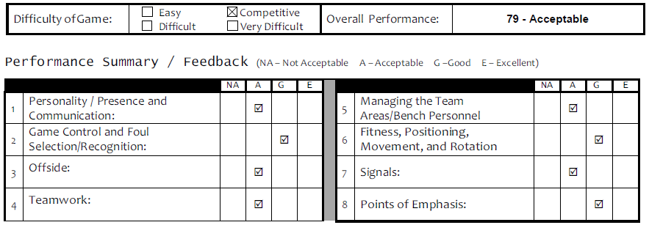
Overall score
Concept is that the overall score is justified by the individual focus area ratings and the text feedback.
When they’re all consistent, the overall score isn’t an issue!

Slide 29
Overall score - recommendation
Based on what the evaluator has seen, and in consideration of the written feedback:
Can this official be expected to handle a more difficult game?
Can this official be expected to handle a game at this difficulty level?

Slide 30
Putting it all together
For formal PIAA evaluations (e. g., state tournament), there is a single evaluation packet that is distributed to all members of the officiating crew (this is a ‘group project’ in school!)
Let’s look at a few sample evaluations…

Slide 31
Sample evaluations

Slide 32
Summary
Four key components
Feedback
Performance focus areas
Difficulty
Overall score
Evaluate for the expected level of an interscholastic official

Slide 33
Questions?

