Slide 1
DOUBLE-DUAL SYSTEM ( DDS): (A 3 referee , 3 whistle officiating system)
FOR PIAA REGULAR SEASON
&
PLAYOFF GAMES

Slide 2
Principle:
Three qualified referees work together as a team to manage the game
All three function on the field:
  Can move on and off the field, as needed
  Stay close to play and players

Slide 3
Principle (cont.)
Equally share in control:
  A decision by any one is valid
  All record misconduct to assure completeness
  Concentrate attention in specific areas:
    Where patterns make observation most effective
    All responsible for any violations

Slide 4
Referee Responsible for Managing Restart and Second Whistles (when required)
Restart Referee
1. Start of Play Center
2. Free Kicks Center except if deep in defensive end)
3. Off side Center
4. Substitution Per stoppage (or CR if agreed in pre-game)
5. Corner Kick Side Referee OR CR (closest to kick)
6. Goal Kick Center
7. Penalty Kick Center
8. Throw in Side Referee( or CR if agreed in pre-game)
9. Drop Ball (closest offensive official not dropping the ball)
10. Signals (CR always signal direction/ SR mirror direction on throw in side/ ALL indicate IFK)

Slide 5
Rotation Intervals:
(rotation should be done during a stoppage of play)
Between the 26th & 27th minutes
( about 13-14 minutes left in the half)
Far side official and Center official change positions
#2 CR ends the first half and restarts the second half
Before starting the 2nd half, side referees exchange positions
Between the 53rd & 54th minutes (about 26-27 minutes left in the game)
Far side official and Center official change positions

Slide 6
OVERTIME PERIODS
Regular season 2x10
POST Season 2x15
(5 minute break flip coin)
Referee Rotation
Start as original crew set up - #1 CR handles the 1st 7 minute first overtime period (10 min post season),
#2 CR handles last 3 min of first half (5 min Post Season), and first 3 (5 post season) min of second half. (side referees switch sides during the ½ time interval (2 minute interval)
#3 CR handles the last –7 min of second OT period (10min Post season)
#1 CR handles the administration and execution of the “kicks” if required, CR 2 & 3 handle players and goal judge.
ALL OVERTIME PERIODS ARE “GOLDEN GOAL”

Slide 7
TAKING OF KICKS any players on the roster (who have not been disqualified) are eligible to participate
(flip a coin, the winner shall have a choice of kicking first or second)
The coach will select 5 eligible players to participate in the 1st set of kicks.
ANY player receiving a caution within the last 5 min of the second overtime period will NOT be permitted to participate in the 1st set of kicks (5 kicks).
The cautioned player IS allowed to participate in the 2nd set of kicks.
ANY Player cautioned during the 5 minute interval between the last over time period and the start or the kicks must sit out for the 1st set of kicks(5 kicks)
If ANY player participating in kicks is cautioned BEFORE his/her turn to kick, they are not eligible to participate in ANY REMAINING KICKS REGARDLESS OF HOW MANY KICKS REMAIN. That player may be replaced.
If any player is disqualified RED CARD (including a goalkeeper) during the taking of kicks, that player may no longer participate, but a substitute is permitted if their kick has not yet been taken.
If the score remains tied after the completion of 5 kicks, the coach will select 5 different eligible players to participate in the next set of 5 kicks. This set of kicks is a “sudden victory” set. If team A scores, and team B misses, then the game is over, and team A is the winner.

Slide 8
Continuation of Kicks
(after each team has taken 5 kicks, and the score remains tied)
■ The coach will select 5 different eligible players to participate in the Sudden Victory kicks. (ONLY if a team has less that 10 eligible players, may a player who has already participated kick again.)
■ If the score remains tied, continue the sudden victory kicks with the coach selecting ANY 5 players to participate in the continuation of sudden victory kicks.

Slide 9
WEATHER
Lightning procedure (pg,8 ) 30 second flash to bang (clear field)
30 minute wait (in a protected area) from the LAST SIGHTED lighting flash.

Slide 10
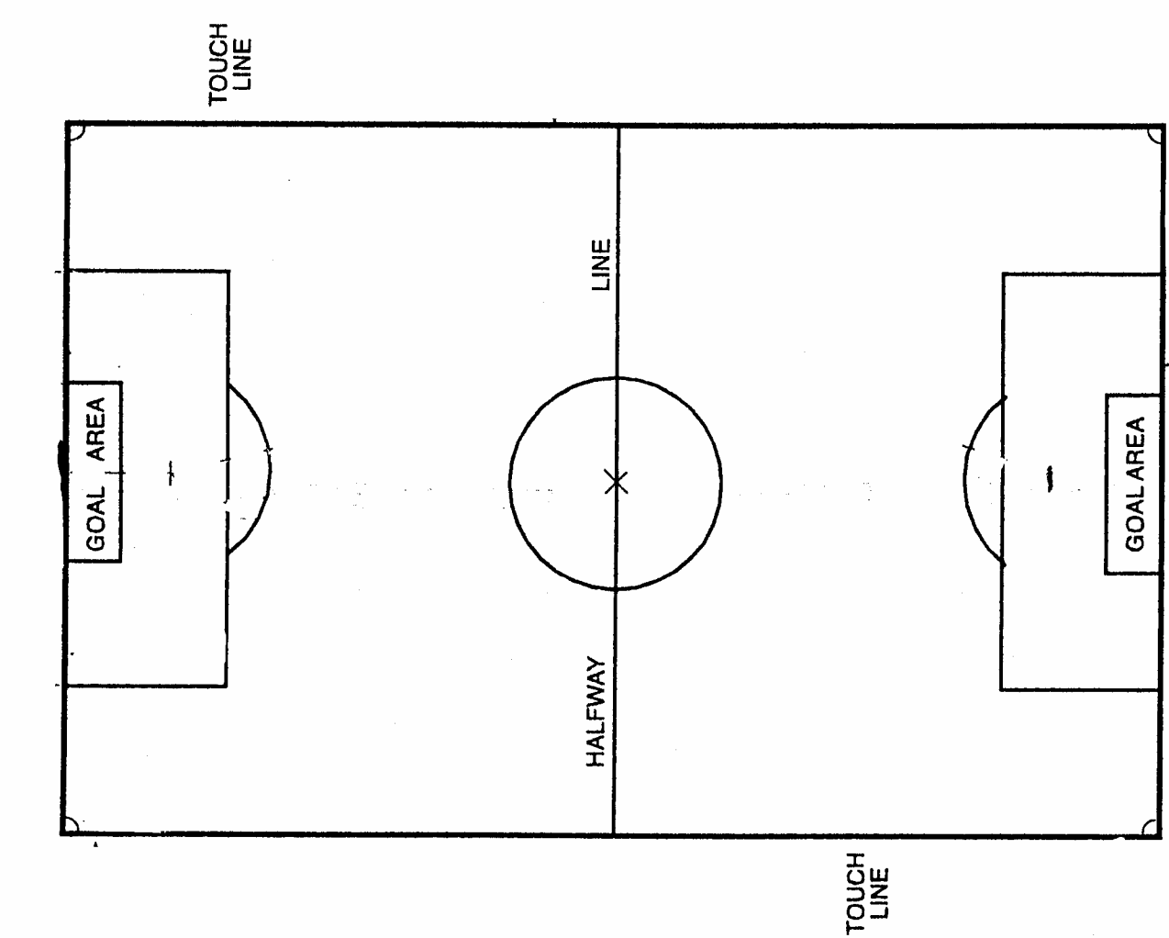
        COVERAGE AREAS
SIDE REFEREE
CENTER REFEREE
SIDE REFEREE

Slide 11
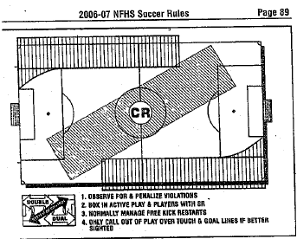
Coverage Areas

Slide 12
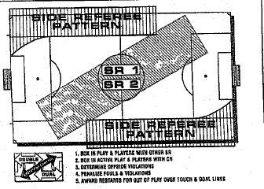

Slide 13
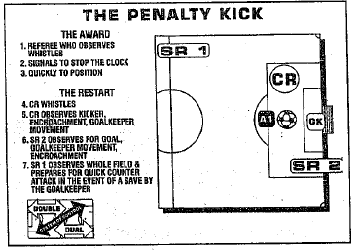

Slide 14
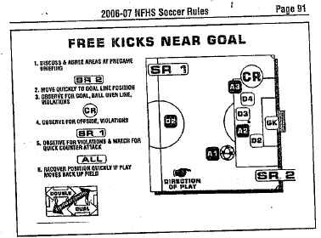

Slide 15
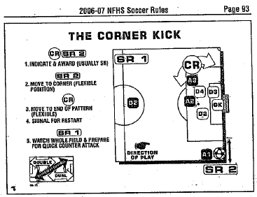

Slide 16
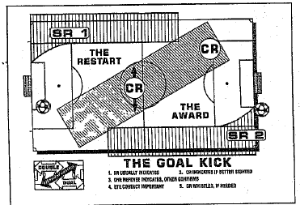

Slide 17
