Slide 1
PIAA 2023-24 Season

Slide 2
PIAA 2023-24 Season
A Wall is set up by the defending team at the appropriate distance from the spot per the official, and another player from the defending team lays down behind the Wall.
Before allowing the play to start, the official must instruct the player to stand up.
12.7.1e: Reference (Dangerous Play)

Slide 3
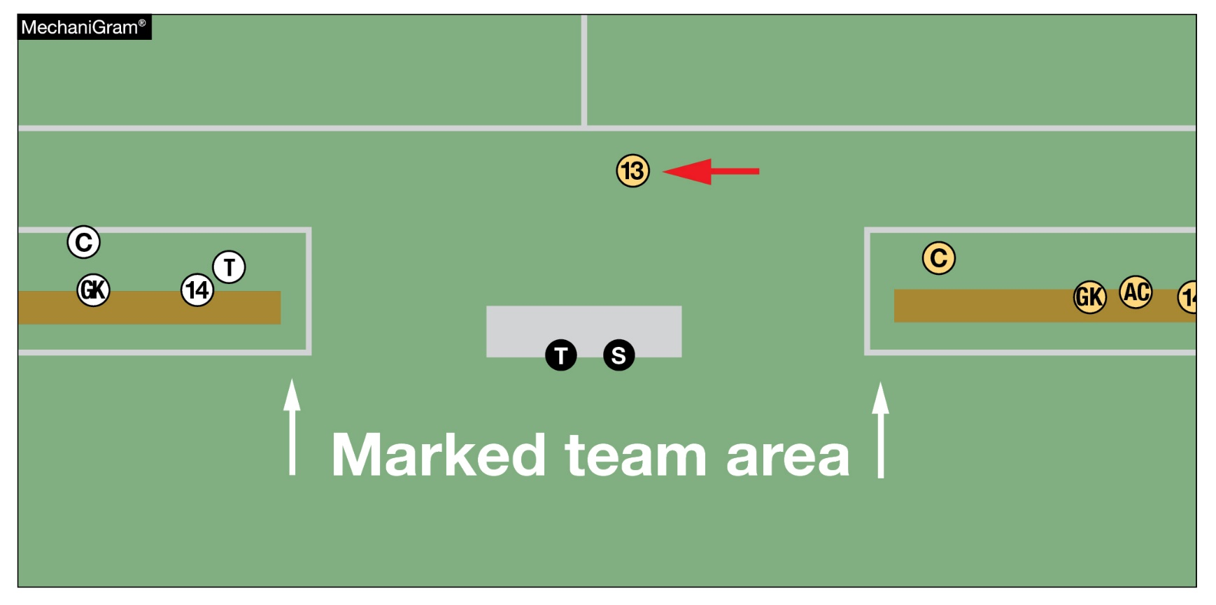
PIAA 2023-24 Season

Slide 4
PIAA 2023-24 Season
Substitution Box:
All Players must be Beckoned onto the field from the Sub Box.
All Players must enter the field at mid field, Sub Box.
The Player being replaced shall exit the field on the bench side unless they are unable to do so because of injury. Exiting Players shall exit directly to their team bench.

Slide 5
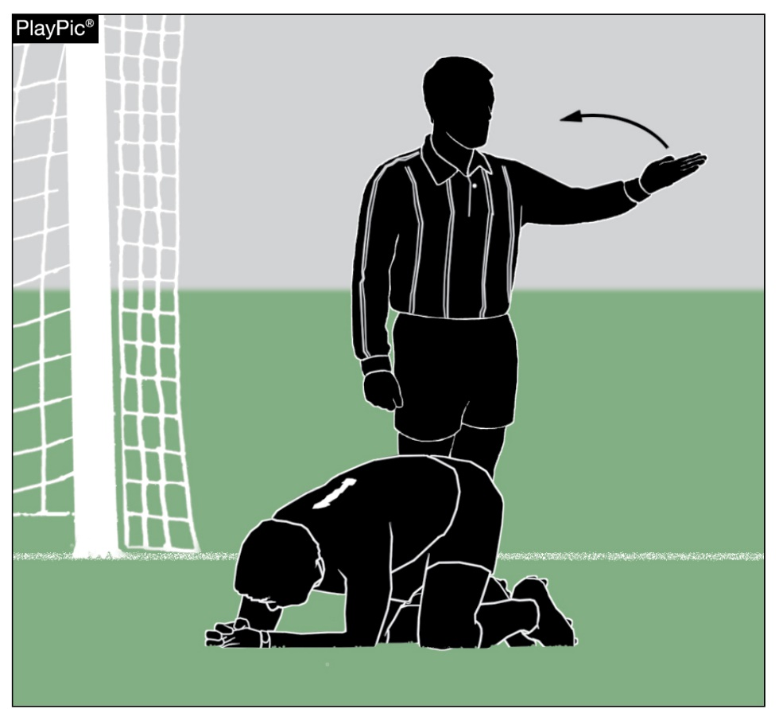
PIAA 2023-24 Season
Spectator or spectators consistently interfering with game management. The Head Referee stops the match and asks the Site Manager to address the behavior of the spectator or spectators.
Head Referee will pause the game until the situation has been corrected.
Head Referee has the authority to terminate the game.

Slide 6
PIAA 2023-24 Season
If the Referee stops the clock to check on a player, the player does not have to leave the field unless the Coach or appropriate health care professional is beckoned onto the field for an apparent injury to the player, the player shall leave the field.

Slide 7
PIAA 2023-24 Season

Slide 8
PIAA 2023-24 Season
Mercy Rule: The Mercy Rule cannot go into effect until the second half. When one team gains a 6 goal differential over its opponent the Mercy Rule will be applied to the match, second half only. Upon scoring the 6th goal the officials should stop the clock to allow for any substitutions before taking the Kick Off. When the clock starts for the Kick Off, AFTER the 6th goal has been scored, it will be a running clock after goals. The officials will stop the clock for injuries, cautions, or any other time the officials deem appropriate. ADDITION: Once the Mercy Rule is applied during the second half, if the team in the lead decides to substitute during the last 5 minutes THE CLOCK SHOULD NOT BE STOPPED. The Mercy Rule takes priority over the new rule whereby the clock is stopped if the team in the lead decides to sub during the last 5 minutes of the second half (All levels of competition)

Slide 9
PIAA 2023-24 Season
Sportsmanship Message: PIAA requires all registered sports' officials to enforce the sportsmanship rules for coaches and contestants. Actions meant to demean opposing contestants, teams, spectators, and officials are not in the highest ideals of interscholastic education and will not be tolerated. Let today's contest reflect mutual respect. Coaches please certify to the contest official(s) that your contestants are legally equipped and uniformed according to NFHS rules and PIAA adoptions, or will be at the kick off. Good luck in today's contest.
Arrival at the Site: At least thirty minutes prior to the scheduled kickoff.
Suspended Game: Rule 7-1-3 (PIAA Modification) The Head Referee shall declare it an official Contest if one complete half or more of the Contest has been played. If less than one-half of the Contest has been played, the game shall be restarted from the suspension of play. In the event a winner must be determined for regular season tournament or to advance during a post season Contest, the Contest shall be resumed at the point of suspension.

Slide 10
PIAA 2023-24 Season
Caution/Yellow Card: Modify Rule 12-8-1 PENALTY, to provide for a 5-minute playing time sit out following the issuance of a yellow card to a player, with the opportunity for that player’s Team to substitute for that player.
Appropriate Health Care Professional – PIAA – MD or DO only!
Dual or Double Dual System of Control only (Modify Rule 5-1-1 NOTE)
PIAA continues to utilize the pre-2011-2012 NFHS Official Soccer Signals
PIAA Affiliated Schools: All games involving a PIAA school must use PIAA RULES.
Tie Contest (Regular Season, Varsity only) – (after 2 x 40 min periods of play) play a maximum of 2-ten minute periods of “Sudden Victory”

Slide 11
PIAA 2023-24 Season
Official Time: Rules 6-2-1 and 6-2-3: The official time/score is to be kept by the scorer at the scoring table or on the scoreboard/clock. Official time is not to be kept by the on field Official.
Official Ball: Wilson VIVIDO (March 2022) NOTE: Member schools are reminded that the adoption is for use during the PIAA District and PIAA State Championship play. Schools are NOT required to use these balls during their regular season contests.
Officials’ Uniform: Shirt – Long or Short sleeved alternating black and white 1-inch vertically striped shirt with a black collar or pro style Black or Yellow shirt. All officials must dress alike. Shorts – Black (long trousers, culottes or skirt may also be worn. Stockings – Long black with three white stripes at the top. Shoes– Solid Black or Predominantly Black with some white, cleaned, and shined. No jewelry except wedding bands and medical-alert bracelets.
Ejection (Red Cards): Report to PIAA AND to Rules Interpreter (Ken Johnson - kjohn6363@aol.com)

Slide 12
PIAA 2023-24 Season
Pre-Game Preparation
On the way to the Match
Match Site (part of your pre-game must include inspection of the field)

Slide 13
PIAA 2023-24 Season
PIAA has again adopted the 2011-2012 NFHS Official Soccer Signals
Modify Rule 3-4-3, Rule 7-1-5 is implemented during the second half (running clock after goals), if the team in the lead substitutes during the last 5 minutes of the second half, the clock will not stop and continue to run. 7-1-5, running clock after goals, except for injuries, or as determined by the official, at all levels (varsity, JV, or otherwise) of competition, when one team gains a 6-goal differential over its opponent during the second half

Slide 14
PIAA 2023-24 Season
12-8-1 Penalty Yellow Card, provides a 5-minute playing time sit out following the issuance of a yellow card to a player, with the opportunity for that player’s Team to substitute for that player.
Water Break: 7-4-1, Referee can stop the clock for a water break if a team request the break and the temp is 86 degrees as the base line.
Rule-3-2,3 (NEW): Clarifies that neither accidental nor deliberate hand/arm contact (Handball) can result in a goal.

Slide 15
PIAA 2023-24 Season
Secure Woven in hair beads are permitted (any secure adornment)
Hanging and dangling beads are improper equipment (no caution but needs to be secured)
Cut socks are permitted BUT the under sock must be of similar color as main sock

Slide 16
PIAA 2023-24 Season
Ken Johnson
kjohn6363@aol.com
610-299-7093

