Slide 1
REFEREE TASK FORCE PAY SCALES - SOCCER
October, 2022

Slide 2
MISSION
To examine the current rates for soccer referees across the leagues we service.
Goal - To arrive at an equitable rate among District One leagues.
Goal - To determine an equitable and verifiable “escalator factor” for future increases.

Slide 3
Referee Chapter Comparisons for Fall 2022
 |  | 80 |  | 72
 | Varsity | PAY PER MINUTE | JR Varsity | PAY PER MINUTE | RATIO (Var to JV) | Scrimmages
Pioneer League | $75.00 | $0.94 | $58.00 | $0.81 | 85.93% | Full Fee
Central | $80.00 | $1.00 | $58.00 | $0.81 | 80.56% | Full Fee
Ches-Mont | $75.00 | $0.94 | $59.00 | $0.82 | 87.41% | Full Fee
Bicentennial | $79.00 | $0.99 | $63.00 | $0.88 | 88.61% | Full Fee
Del-Val | $80.00 | $1.00 | $63.00 | $0.88 | 87.50% | Full Fee
Suburban | $79.00 | $0.99 | $63.00 | $0.88 | 88.61% | Full Fee
Independents | $75.00 | $0.94 | $67.00 | $0.93 | 99.26% | Full Fee
Chestmont | $75.00 | $0.94 | $59.00 | $0.82 | 87.41% | Full Fee
Catholic Academy | $80.00 | $1.00 | $60.00 | $0.83 | 83.33% | Full Fee
Catholic League | $87.00 | $1.09 | $70.00 | $0.97 | 89.40% | Full Fee
Mid Pennsylvannia (2 Man) | $89.00 | $1.11 | $71.00 | $0.99 | 88.64% | Varies
Lehigh Valley | $77.00 | $0.96 | $65.00 | $0.90 | 93.80% | N/A
Susquehanna Chapter | N/A | N/A | N/A | N/A | N/A | N/A
Lancaster Chapter | N/A | N/A | N/A | N/A | N/A | N/A
Berks | N/A | N/A | N/A | N/A | N/A | N/A
AVERAGE | $79.25 | $0.99 | $63.00 | $0.88 | 88.37%
DELAWARE | $84.00 | $1.0500 | $58.00 | $0.97 | 92.06% | 1/2 FEE
NJ | $89.00 | $1.1125 | $70.00 | $0.97 | 87.39% | FULL
MARYLAND | $90.00 | $1.1250 | $70.00 | $1.00 | 88.89% | FULL
NOTE: Delaware Assignor Fees are paid by the officials 6.5% of Game Fee. Delaware JV is 30-minute halves with running clock.
NOTE: Maryland Public Schools- JV is 30 minute with same timing rules as Varsity. Private Schools pay all sorts of rates $90-$100- Most 3 man.
Next Year they are asking $130 for Center, $65 for ARs. If 2-man $130 each

Slide 4
Note: Southern Chester County will be paying Varsity $95 if paid by cash, $105 if paid by check, and $115 if paid through ArbiterSports.

Slide 5
RATIONALE FOR USING SSN AND/OR COLA DATA FOR ESCALATOR FACTOR
These are tied to increases for other vocations
These are consistently published on a year-to-year basis, usually in January of each year.
They are equitable to both the client and the service provider.
Suggested escalator (in last 2 years’ data plus year-end 2022 estimate):
Currently would be a 3.5-5% increase based on the historical and last 3 years data.
Note: As rates go up, a $2.00 annual increase, as has been standard, causes the gap to become greater, as this is not keeping pace with either COLA or inflation rate.

Slide 6
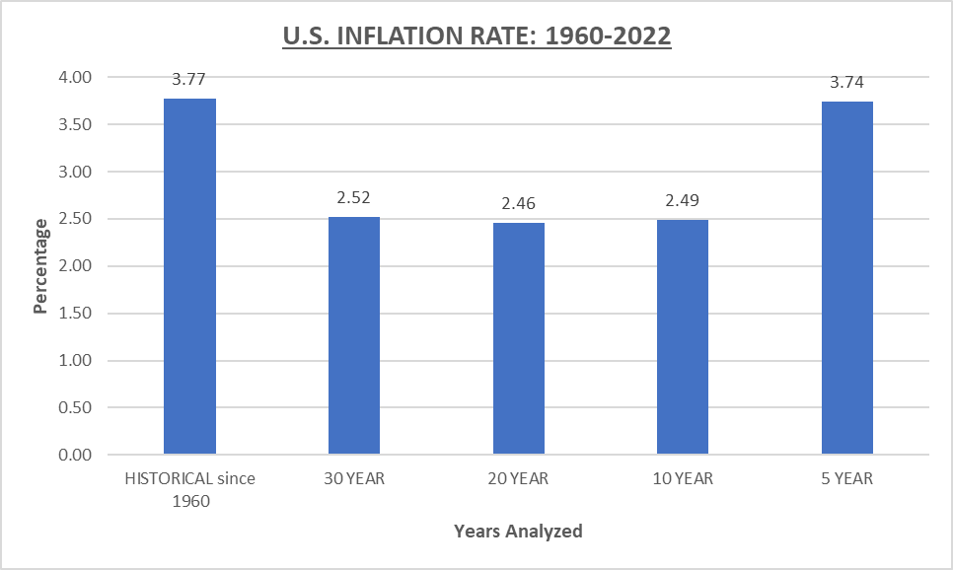
Three-year inflation rate is 4.81%, with an 8.5% year-end estimate in 2022.

Slide 7
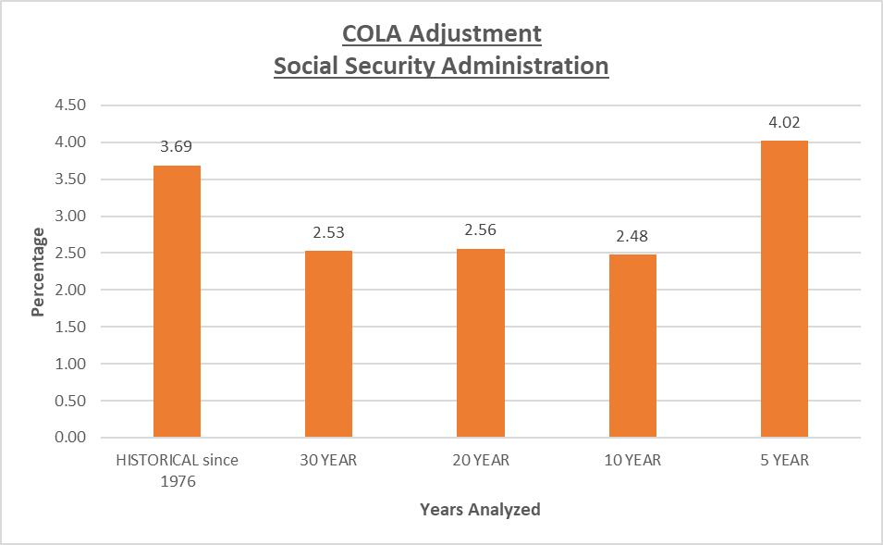
Three-year rate is 5.23%, with an 8.5% year-end estimate in 2022.

Slide 8
Recommendations: the bottom line
Fix the 2023 Varsity rate for all District One leagues at between $85-$95.
Increase the JV game length to 40-minute halves, and the rate will be 90% of the Varsity rate.
Propose that overtime during the regular season be eliminated.
The escalator for each year should be the average of the last three years’ increase in the CPI.
Middle School games to move to the Spring of each interscholastic year.
Games should be double dual where possible.

Slide 9
 | AVERAGE RATES WHEN SUGGESTED BY TASK FORCE
 | VARSITY | $ INC | PPM | % INC | JV | $INC | PPM | % INC | RATIO | FR | RATIO
2023 | $88.00 | $9.00 | $1.10 | 10.23% | $77.00 | $8.00 | $0.96 | 10.39% | 88% | $65.00 | 74%
2024 | $91.00 | $3.00 | $1.14 | 3.30% | $79.00 | $2.00 | $0.99 | 2.53% | 87% | $68.00 | 75%
2025 | $94.00 | $3.00 | $1.18 | 3.19% | $81.00 | $2.00 | $1.01 | 2.47% | 86% | $71.00 | 76%
2026 | $97.00 | $3.00 | $1.21 | 3.09% | $83.00 | $2.00 | $1.04 | 2.41% | 86% | $74.00 | 76%
2027 | $100.00 | $3.00 | $1.25 | 3.00% | $85.00 | $2.00 | $1.06 | 2.35% | 85% | $77.00 | 77%
 | RATES WHEN APPLYING SUGGESTED ESCALATOR AND RATIOS
 | VARSITY | $ INC | PPM | % INC | JV | $INC | PPM | % INC | RATIO | FR | RATIO
2023 | $88.00 | $9.00 | $1.10 | 10.23% | $79.00 | $10.00 | $0.99 | 12.66% | 90% | $66.00 | 75%
2024 | $92.40 | $4.62 | $1.16 | 5.00% | $83.16 | $4.16 | $1.04 | 5.00% | 90% | $69.30 | 75%
2025 | $97.02 | $4.85 | $1.21 | 5.00% | $87.32 | $4.37 | $1.09 | 5.00% | 90% | $72.77 | 75%
2026 | $101.87 | $5.09 | $1.27 | 5.00% | $91.68 | $4.58 | $1.15 | 5.00% | 90% | $76.40 | 75%
2027 | $106.96 | $5.35 | $1.34 | 5.00% | $96.27 | $4.81 | $1.20 | 5.00% | 90% | $80.22 | 75%
Soccer Mid PA- MPC |  | 2020-22 | 2022-23 | 2023-24 | 2024-25 | 2025-26
 | 3 Person Varsity Crew | $ 79.00 | $94.00 | $99.00 | $104.00 | $109.00 | 2.5 hrs @ 50% fee all levels
 | 2 Person Varsity Crew | $ 89.00 | $94.00 | $99.00 | $104.00 | $109.00 | Exceed 2.5 hrs full fee all evels
 | JV | $ 71.00 | $76.00 | $81.00 | $86.00 | $91.00
Do not use | Combined Varsity/ JV | $ 124.00 | $153.00 | $162.00 | $171.00 | $180.00 | Requested -refused by officials
 | Junior High (2 games) | $ 82.00 | $84.00 | $86.00 | $88.00 | $90.00
 | Junior High (1 official 2 games) | $ 120.00 | $122.00 | $124.00 | $126.00 | $128.00
 | Junior High (1game) | $65.00 | $67.00 | $69.00 | $71.00 | $73.00
 | Jr. High (2 officilas) 1 game | $67.00 | $69.00 | $71.00 | $73.00 | $75.00

Slide 10
 | Direct Comparison Between Mid PA and District 1 - 5 Year Projection
 | VARSITY | VARSITY | JV | JV | VAR+JV | VAR+JV | DIFF | DISTRICT 1 |  | VAR+JV | VAR+JV
 | MID PENN | DIST 1 | MID PENN | DIST 1 | MID PENN | DIST 1 | NET | VARSITY | JV | DIST 1 | MID PENN
2023 | $94.00 | $88.00 | $76.00 | $79.00 | $170.00 | $167.00 | -$3.00 | $90.00 | $80.00 | $170.00 | $170.00
2024 | $99.00 | $92.00 | $81.00 | $83.00 | $180.00 | $175.00 | -$5.00 | $95.00 | $85.00 | $180.00 | $180.00
2025 | $104.00 | $97.00 | $86.00 | $87.00 | $190.00 | $184.00 | -$6.00 | $100.00 | $90.00 | $190.00 | $190.00
2026 | $109.00 | $101.00 | $91.00 | $92.00 | $200.00 | $193.00 | -$7.00 | $105.00 | $95.00 | $200.00 | $200.00
2027 | $115.00 | $105.00 | $96.00 | $96.00 | $211.00 | $201.00 | -$10.00 | $110.00 | $100.00 | $210.00 | $211.00
Takeaways:
Direct comparison with Mid-Penn was used due to:
it’s the same state, it’s approximately the same geographical location
demographic information is more similar than other states or regions
these are PIAA schools
Mid-Penn Varsity rate is higher, but JV rate is slightly lower.
Mid-Penn appears to be using an approximately 5% escalator rate; however, we are only using a 3% escalator rate, which is illustrated by the increasing net difference (in red) over the period.
Based on all data reviewed, the District One rates should be those in blue and orange.
Please note: this will vary due to the escalator factor used because in some years it may increase more than 5%, and other years it may be less. It was suggested an average of 3 years be used to avoid sharp increases or decreases in rates.

Slide 11
Increase and Pay Rate Scenarios
 | $88 Varsity Rate 90% JV Ratio- Direct Comparison Between Mid PA and District 1 - 5 Year Projection
 | VARSITY | VARSITY | JV | JV | VAR+JV | VAR+JV | DIFF | DISTRICT 1 |  | VAR+JV | VAR+JV
 | 40 | 79 | 40 | 5% | 40 | 69 |  |  |  | 40 | 69
 | MID PENN | DIST 1 | MID PENN | DIST 1 | MID PENN | DIST 1 | NET | VARSITY | JV | DIST 1 | MID PENN
2023 | $94.00 | $88.00 | $76.00 | $79.00 | $170.00 | $167.00 | -$3.00 | $90.00 | $80.00 | $170.00 | $170.00
2024 | $99.00 | $92.00 | $81.00 | $83.00 | $180.00 | $175.00 | -$5.00 | $95.00 | $85.00 | $180.00 | $180.00
2025 | $104.00 | $97.00 | $86.00 | $87.00 | $190.00 | $184.00 | -$6.00 | $100.00 | $90.00 | $190.00 | $190.00
2026 | $109.00 | $101.00 | $91.00 | $92.00 | $200.00 | $193.00 | -$7.00 | $105.00 | $95.00 | $200.00 | $200.00
2027 | $115.00 | $105.00 | $96.00 | $96.00 | $211.00 | $201.00 | -$10.00 | $110.00 | $100.00 | $210.00 | $211.00
 | $88 Varsity Rate 90% JV Ratio- Direct Comparison Between Mid PA and District 1 - 5 Year Projection
 | VARSITY | VARSITY | JV | JV | VAR+JV | VAR+JV | DIFF | DISTRICT 1 |  | VAR+JV | VAR+JV
 | MID PENN | DIST 1 | MID PENN | DIST 1 | MID PENN | DIST 1 | NET | VARSITY | JV | DIST 1 | MID PENN
2023 | $94.00 | $85.00 | $76.00 | $76.00 | $170.00 | $161.00 | -$9.00 | $85.00 | $76.00 | $161.00 | $170.00
2024 | $99.00 | $90.00 | $81.00 | $81.00 | $180.00 | $171.00 | -$9.00 | $90.00 | $81.00 | $171.00 | $180.00
2025 | $104.00 | $95.00 | $86.00 | $86.00 | $190.00 | $181.00 | -$9.00 | $95.00 | $86.00 | $181.00 | $190.00
2026 | $109.00 | $100.00 | $91.00 | $90.00 | $200.00 | $190.00 | -$10.00 | $100.00 | $90.00 | $190.00 | $200.00
2027 | $115.00 | $105.00 | $96.00 | $95.00 | $211.00 | $200.00 | -$11.00 | $105.00 | $95.00 | $200.00 | $211.00
 | $85 Varsity Rate 85% JV Ratio- Direct Comparison Between Mid PA and District 1 - 5 Year Projection
 | VARSITY | VARSITY | JV | JV | VAR+JV | VAR+JV | DIFF | DISTRICT 1 |  | VAR+JV | VAR+JV
 | MID PENN | DIST 1 | MID PENN | DIST 1 | MID PENN | DIST 1 | NET | VARSITY | JV | DIST 1 | MID PENN
2023 | $94.00 | $85.00 | $76.00 | $72.00 | $170.00 | $157.00 | -$13.00 | $85.00 | $72.00 | $157.00 | $170.00
2024 | $99.00 | $90.00 | $81.00 | $77.00 | $180.00 | $167.00 | -$13.00 | $90.00 | $77.00 | $167.00 | $180.00
2025 | $104.00 | $95.00 | $86.00 | $81.00 | $190.00 | $176.00 | -$14.00 | $95.00 | $81.00 | $176.00 | $190.00
2026 | $109.00 | $100.00 | $91.00 | $85.00 | $200.00 | $185.00 | -$15.00 | $100.00 | $85.00 | $185.00 | $200.00
2027 | $115.00 | $105.00 | $96.00 | $89.00 | $211.00 | $194.00 | -$17.00 | $105.00 | $89.00 | $194.00 | $211.00

Slide 12
Next steps
Task Force Will Meet to Discuss Options to present to Chapter
Chapter members will need to discuss during a Chapter meeting.
Finalize proposal to be submitted to assigners for presentation to the leagues.
Further action based on league’s acceptance or rejection or counteroffer to proposal.

